Slide 1

Session 5
Selenium WebDriver - Selenium API

Slide 2
Knowledge Check
Session 4
What are basic methods to work with textbox and button?
Explain getText().
How to get the attribute and style properties of an element?
Different methods to select a value from dropdown?
Explain isSelected, isDisplayed and isEnabled.

Slide 3
Topics
Covered
Checking an element's presence
Checking an element's state
Using Advanced User Interactions API for mouse and keyboard events
Performing double-click on an element
Performing drag-and-drop operations
Working with context menus
Executing the JavaScript code
Capturing screenshots with Selenium WebDriver
Maximizing the browser window
Working with browser navigation

Slide 4
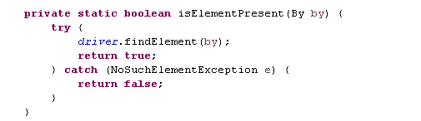
Checking an element's
presence
We will write a isElementPresent() method.

Slide 5
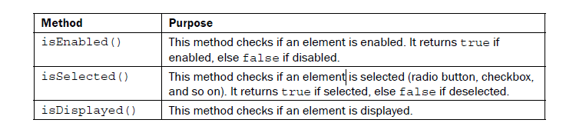
Checking an element's
state
WebDriver facilitates the user with the following methods to check the visibility of the web elements. These web elements can be buttons, dropboxes, checkboxes, radio buttons, labels etc.

Slide 6
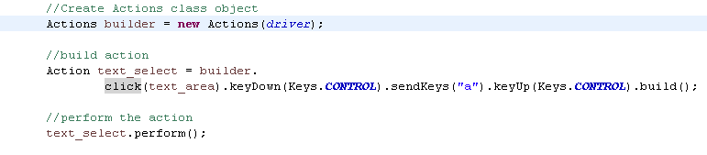
Using Advanced User Interactions API
for mouse and
keyboard events
Selenium WebDriver's API –
  Perform operations from keyboard events
  Simple mouse events
  Complex events such as dragging-and-dropping, holding a key and then performing mouse operations using the Actions class, b
  Building a complex chain of events exactly like a user doing these manually.
The Actions class implements the builder pattern to create a composite action containing a group of other actions.

Slide 7
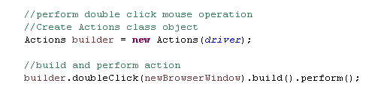
Performing double-click
on an element
The Advanced User Interaction API provides a method to perform a double-click.
We will use the Actions class to perform double-click operations.

Slide 8


Performing drag-and-drop
operations
The Advanced User Interaction API provides a method to perform a drag-and-drop.
We will use the Actions class to perform drag-and-drop operations.

Slide 9
Working with
context menus
The Selenium WebDriver Actions class provides the contextClick() method to perform a right-click operation.

Slide 10
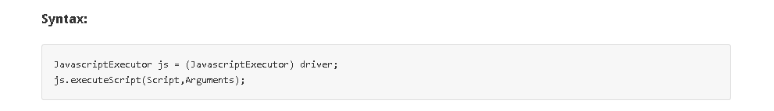



Executing the
JavaScript code
Selenium WebDriver provides a JavascriptExecutor interface that can be used to execute arbitrary JavaScript code within the context of the browser.
Examples:

Slide 11

Capturing screenshots with
Selenium WebDriver
Selenium WebDriver provides the TakesScreenshot interface to capture a screenshot of a web page.
This helps in test runs, showing exactly what happened when an exception or error has occurred during execution.

Slide 12
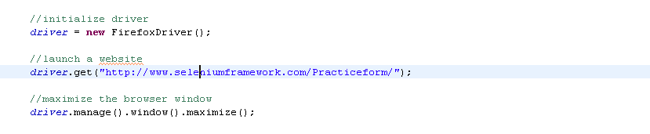
Maximizing the
browser window
To maximize a browser window, we need to call the maximize() method of the Window interface of the driver class.

Slide 13
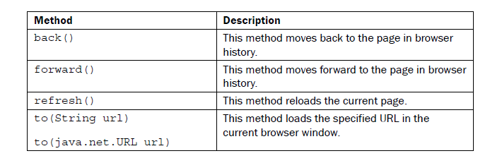
Working with browser
navigation
Browsers provide various us various navigation control methods like refreshing the current page with the back, forward, and refresh/reload buttons on the browser window's toolbar.

Slide 14


Slide 15
Knowledge Check
What is Action Class?
How to perform double click on an element?
What are ways to perform drag and drop?
How to perform the right click in selenium?
How to execute JavaScript in WebDriver? What normal operations it can perform?
what are different browser navigation functions?

Slide 16

Thank you!

